Slide 1


MACHINE DOWNTIME ANALYSIS IN FUEL PUMP MANUFACTURING
Raja. M
DS/DA Intern
Batch-93

Slide 2
Contents
Business Objective
Business Constraints
Project Architecture - Data Flow Diagram
Data Collection
Exploratory Data Analysis
Data Visualization
Notes:
Change

Slide 3
Business Problem
Fuel pump manufacturing relies heavily on machine uptime to maintain consistent productivity.
Frequent unplanned machine downtimes lead to production delays, increased operational costs, and reduced customer satisfaction.
These downtimes are unpredictable and typically arise from mechanical failures, system inefficiencies, or lack of proactive maintenance.
The business objective is to minimize unplanned machine downtimes to ensure optimal production flow and improve equipment reliability.
Tackling this issue is critical for sustaining profitability and competitive advantage.

Slide 4
Project Overview and Scope
This project was initiated to support the Technical Resolution Department, aiming to address the technical root causes of machine failures.
Scope: The solution is tailored to improve diagnostic insights, optimize maintenance schedules, and enable predictive interventions.
Business Constraints: The solution must minimize maintenance costs while delivering meaningful downtime reduction.
Success Criteria:
Business: Achieve at least a 10% reduction in unplanned machine downtime.
Economic: Target cost savings of $1 million through improved machine utilization and reduced failures.

Slide 5
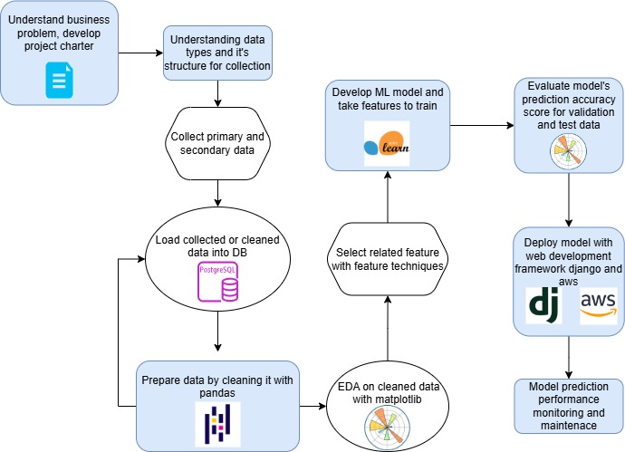
Project Architecture
This architecture represents the end-to-end workflow of the machine downtime analysis project, from understanding the business problem to deploying the predictive model.

Slide 6
Data Dictionary
The dataset used in this project is secondary data provided by the client, recorded from machine sensors over time.
It includes 16 operational parameters like pressures, temperatures, vibrations, and torque, recorded along with timestamps.
Each record represents the performance of a specific machine at a specific point in time.
The target label indicates whether the machine experienced a failure or not at that time.
One column, Spindle_Speed_RPM, was excluded due to outlier contamination affecting analysis reliability.

Slide 7
Exploratory Data Analysis [EDA]
EDA was conducted to examine how machine parameters behave during failure versus normal operation.
Multiple statistical techniques were applied: central tendency, variability, and kurtosis for deeper distribution insights.
Histograms revealed the operational spread and distribution pattern of each parameter.
A comparative analysis between failure and non-failure states helped identify consistently affected parameters.
This laid the foundation for identifying potential predictors for machine failure and downtime risk.
Notes:
EDA is used for seeing what the data can tell us before the modeling task.
Change

Slide 8
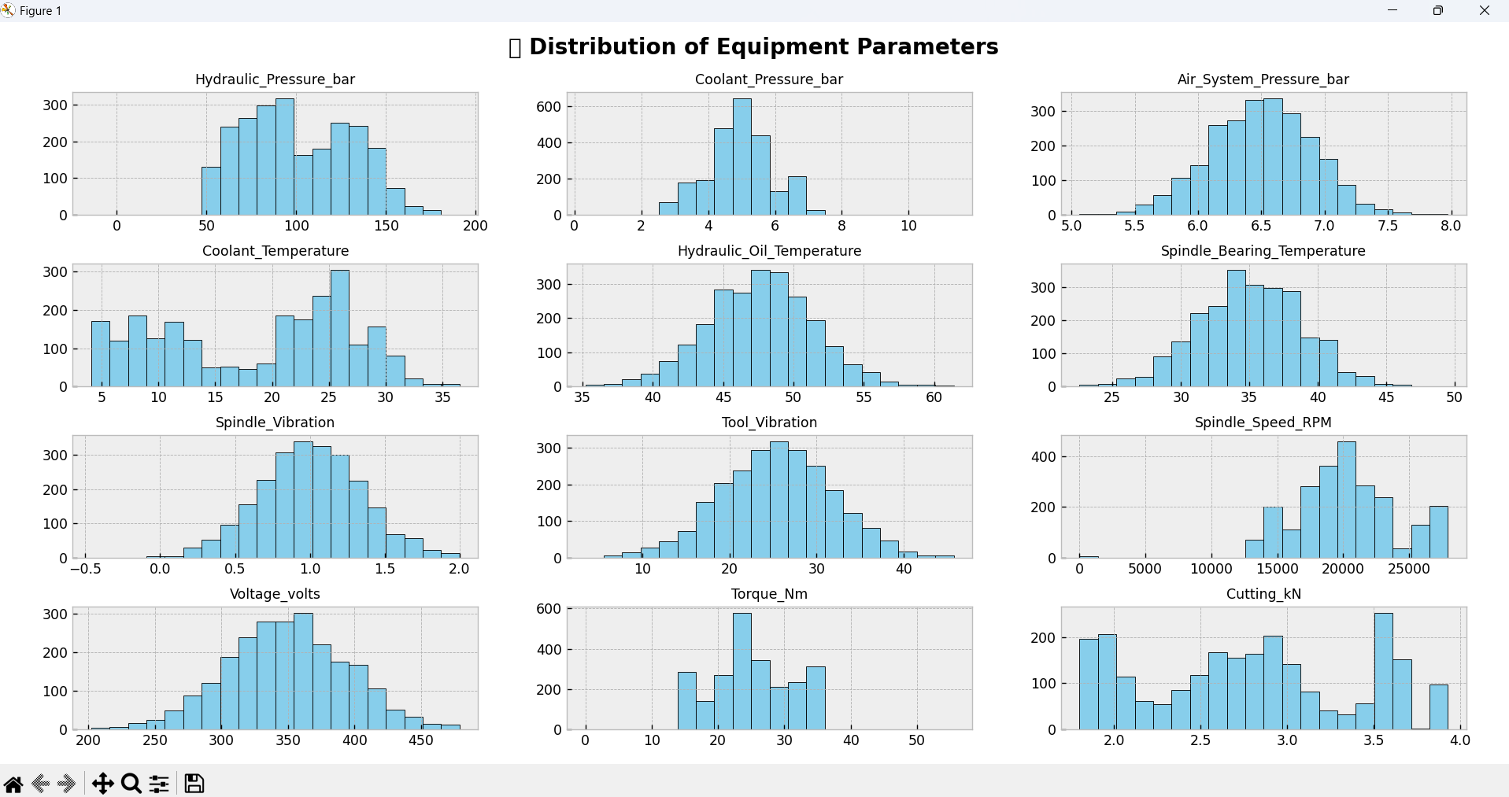
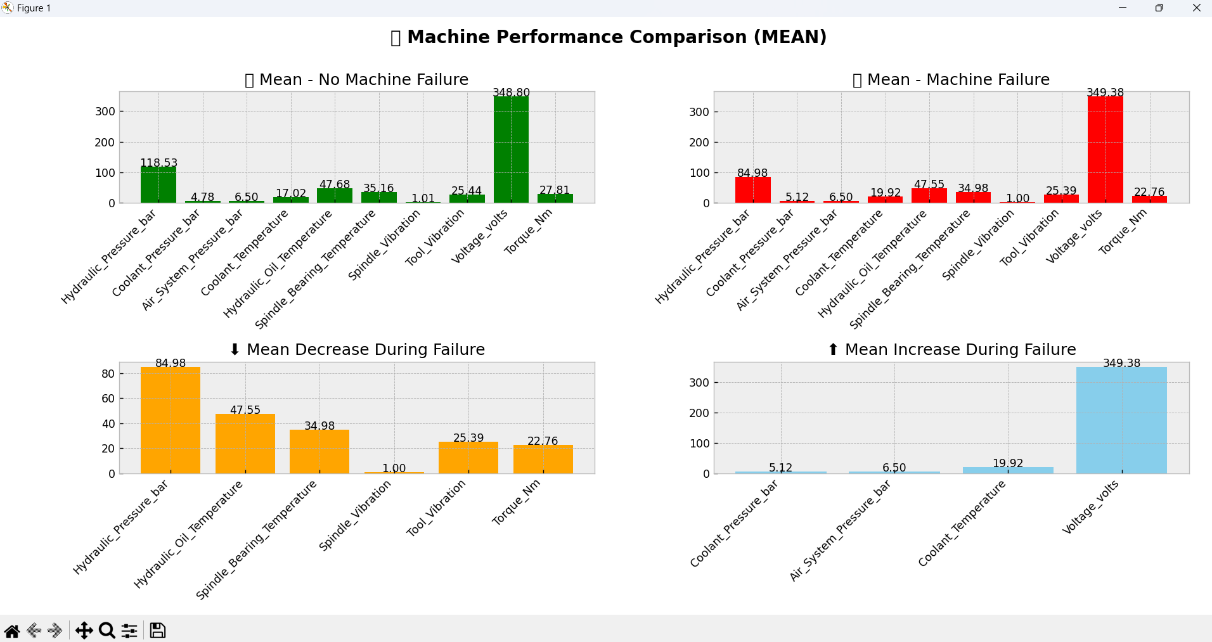
Exploratory Data Analysis [EDA]
Statistical Insights
Business Insights
Notes:
EDA is used for seeing what the data can tell us before the modeling task.
Change

Slide 9
Data Preprocessing
Initial steps included removal of missing values and filtering out outlier data.
The Spindle_Speed_RPM was excluded due to irregular values skewing insights.
Dataset was structured to allow time-series-based analysis, ensuring temporal continuity in understanding machine conditions.
Preprocessing also involved separating failure vs. normal operation data for statistical comparison.
Ensuring clean, consistent data was crucial for generating reliable and actionable EDA results.
Notes:
Keep observations

Slide 10
Data Visualization
Histograms and bar charts were created to visualize the distribution and variation of each parameter.
Visualization allowed easy differentiation of conditions during machine failure and non-failure.
Key trends were highlighted using visual comparisons of mean, median, and max values.
Visuals also exposed which parameters consistently increased or decreased during downtime.
These plots were vital in making complex relationships understandable for technical and non-technical stakeholders alike.
Notes:
Add graphical

Slide 11
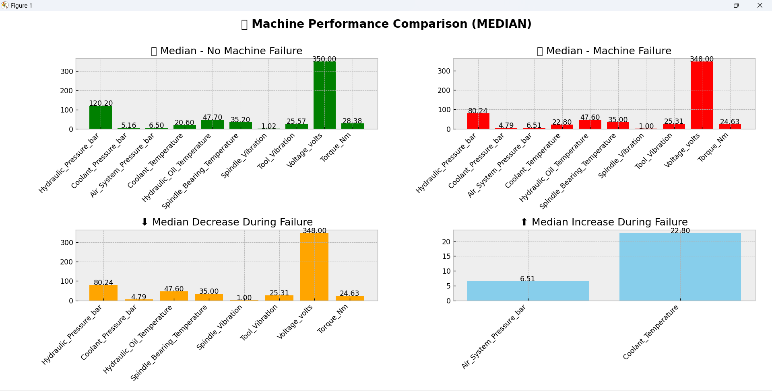
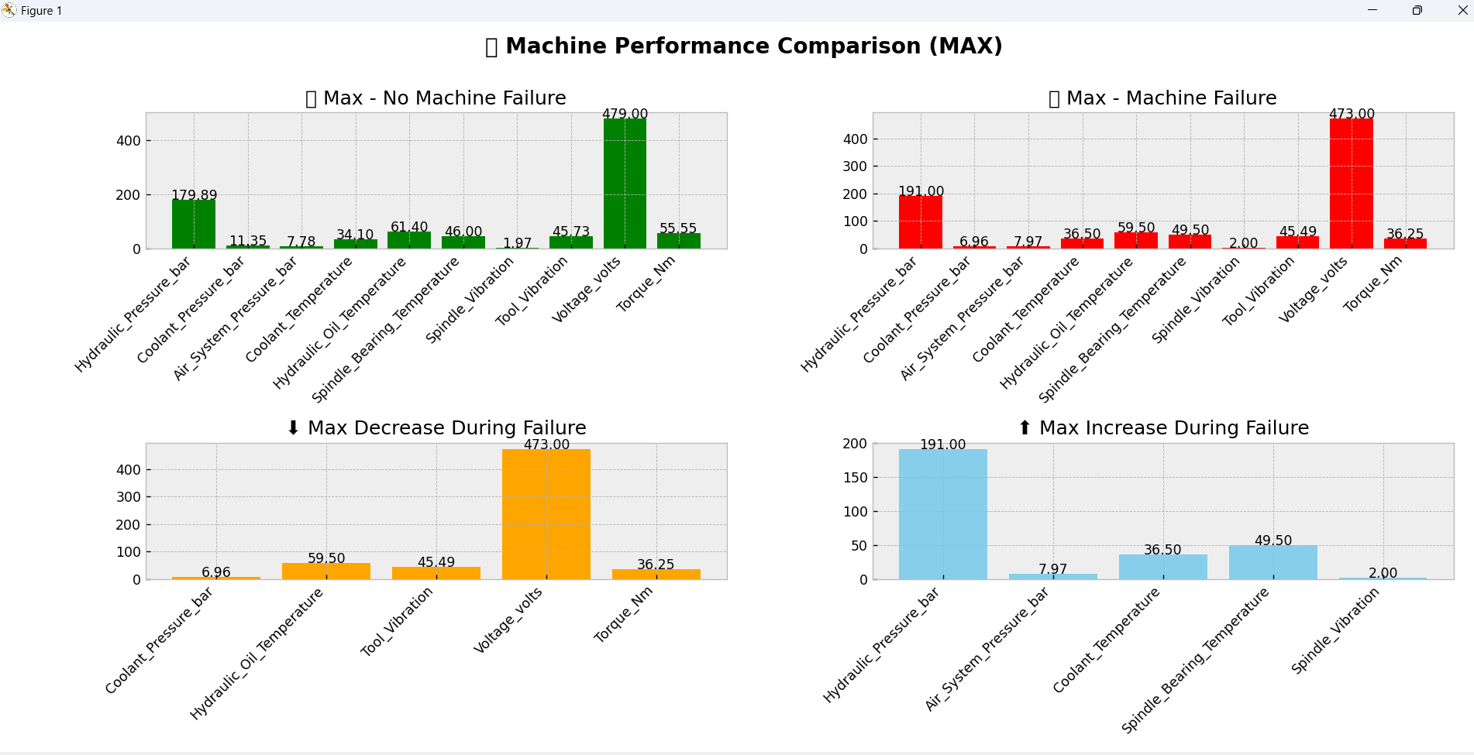
Data Visualization
Notes:
Add graphical

Slide 12


